Slide 1
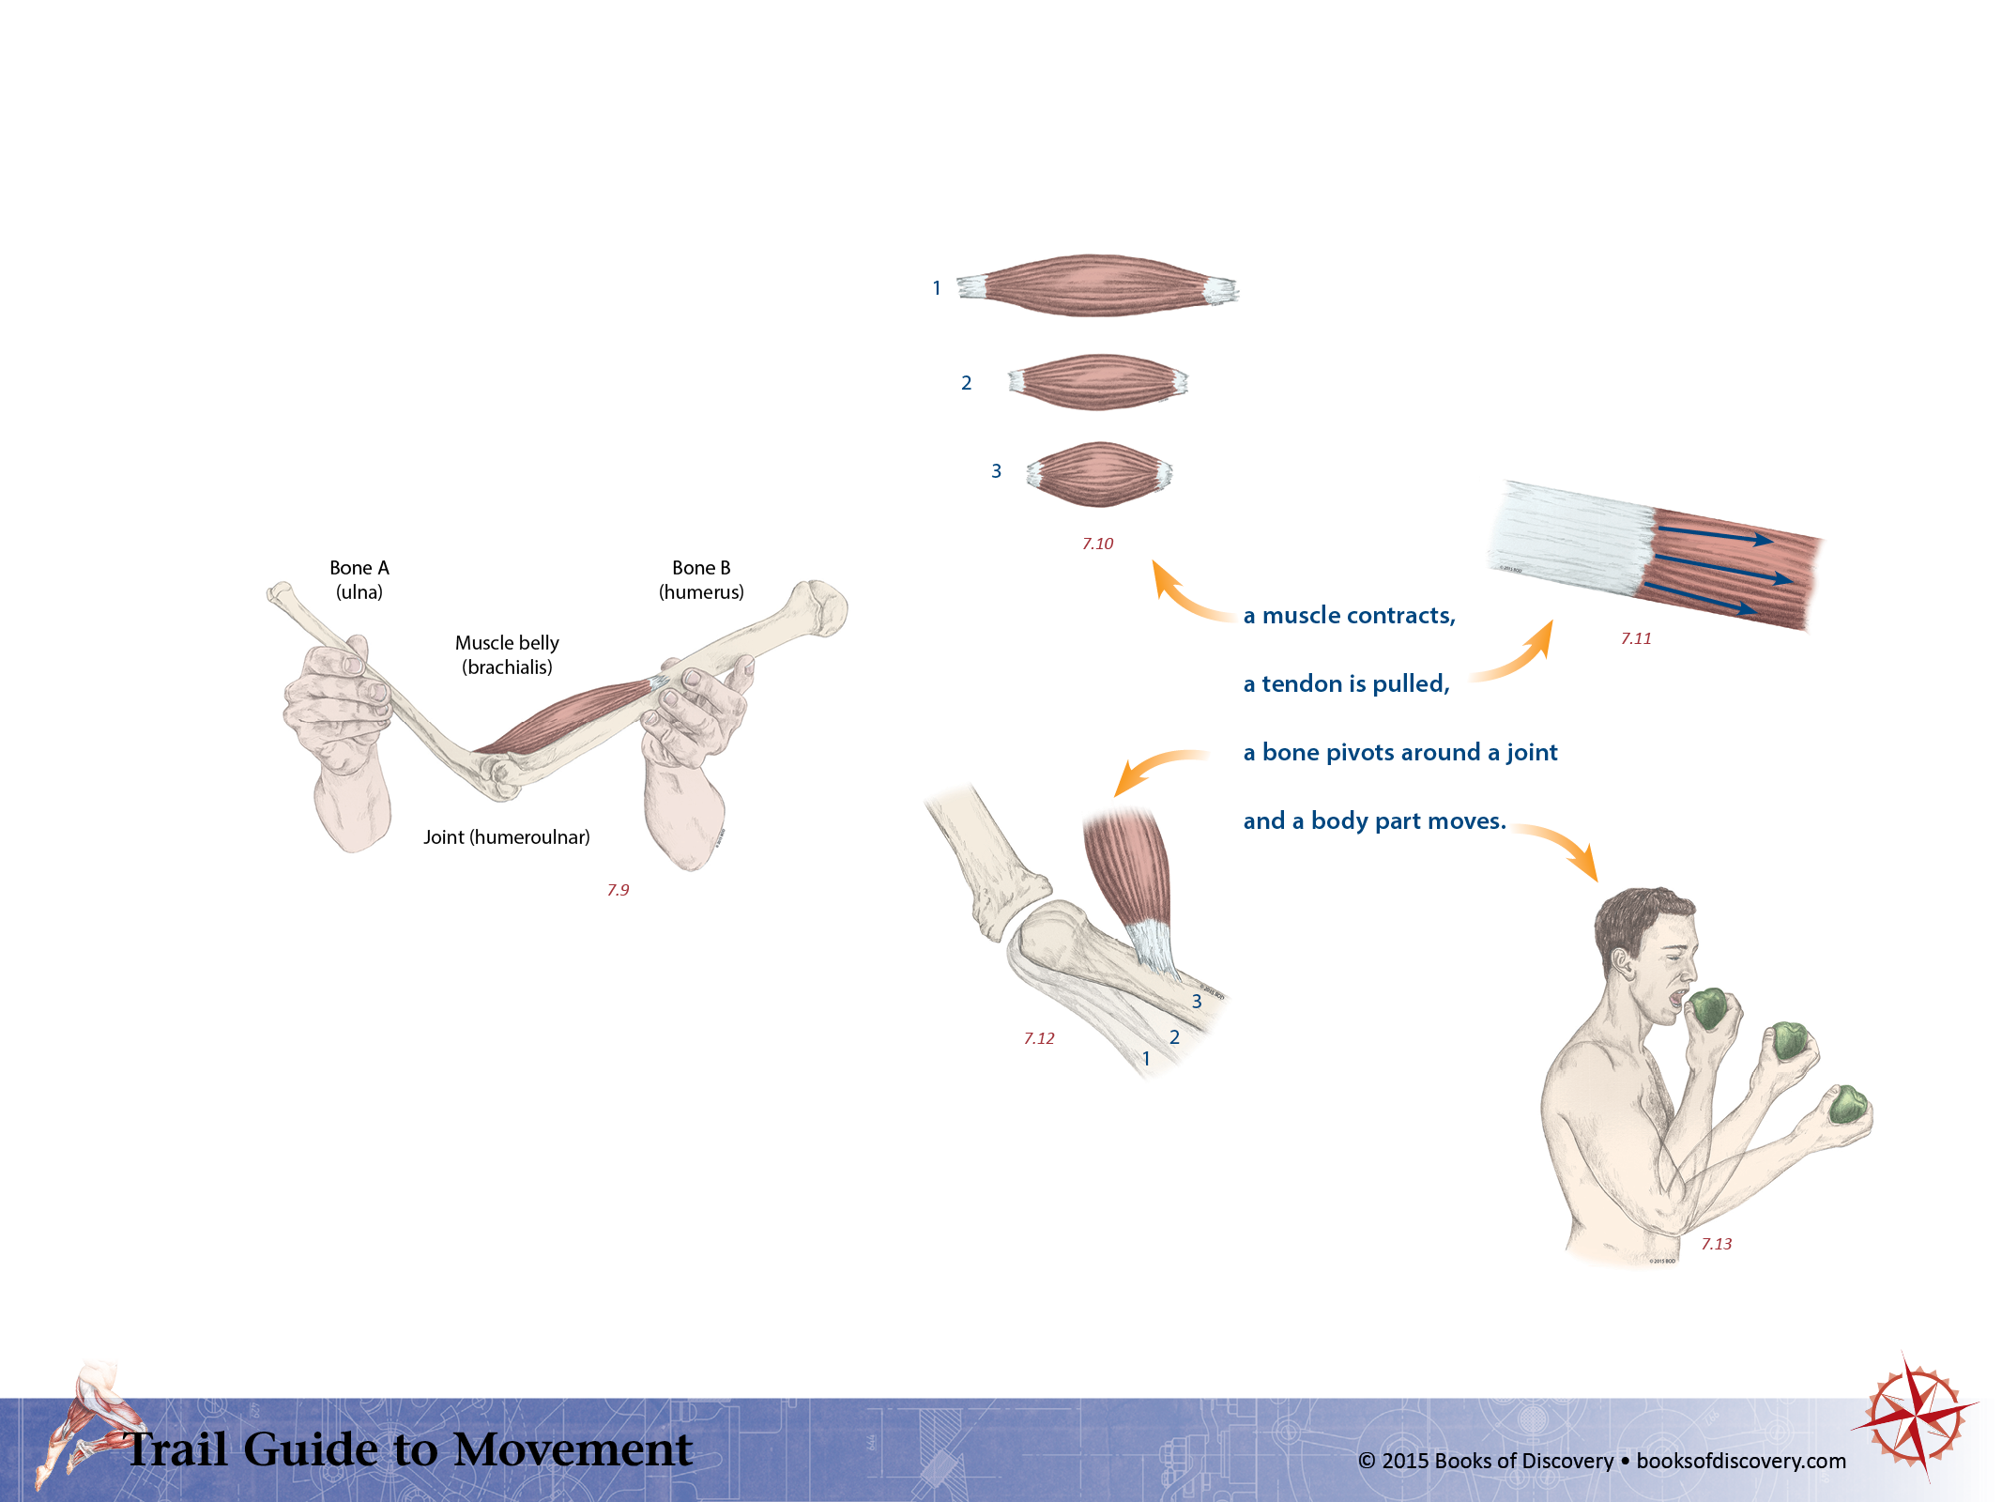
When muscles contract they shorten.
This pulls on the tendon that attaches to (a) bone(s).
With enough force,
this moves a body part.
TGM Page 94

