Slide 1
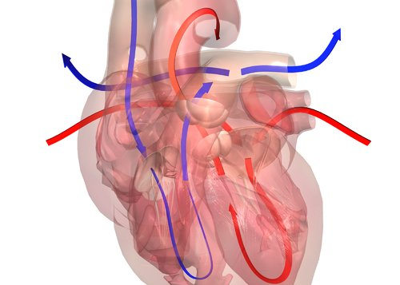
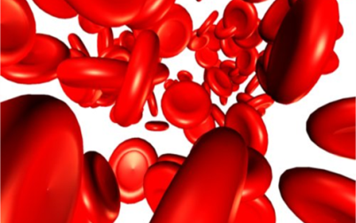
Circulatory System

Slide 2
Cardiovascular System Functions
1. Transportation and distribution
2. Transports Heat
3. Protects body
4. Prevents hemorrhaging
Notes:
Maintains normal ph in tissues. Blood proteins and solutes buffer to prevent excessive or abrupt changes in blood ph
This could endanger normal cellular activities.
Maintains adequate fluid volume salts act to prevent excessive fluid loss, from blood stream into tissues, to support efficient circulation to all areas
Prevents blood loss by clotting platelets and plasma proteins initiate clot formation, stopping blood loss
Prevention of Infection by antibodies, complement proteins, white blood cells defend against foreign invader such as bacteria, viruses, toxins and tumor cells, impurities

Slide 3
Functions
Transportation & distribution
1. Respiratory gases
2. Nutrients
3. Antibodies
4. Hormones
5. Waste Materials
Notes:
Transportation & distribution of;
1. Delivers oxygen from respiratory system
and nutrients form digestion to all body cells
2. Maintains body temp by absorbing and distributing heat
Blood transports heat from active muscles to skin where the heat can be dissipated through vasodilation & perspiration
3. waste materials ; nitrogenous to KI, C0s to Lungs
4. hormones from endocrine system to target organ

Slide 4
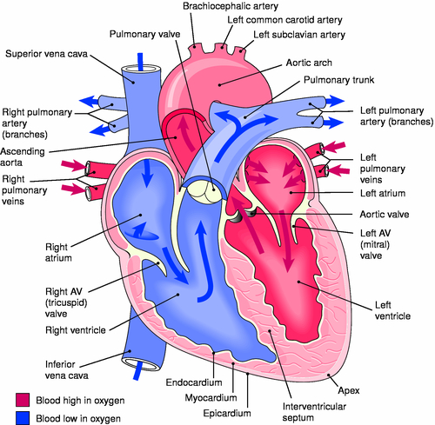
Heart Chambers & Valves
Atria
Ventricles
Tricuspid valve
The bicuspid valve
Semilunar valves
The pulmonary
The aortic
Notes:
Heart Chambers
the hollow heart is subdivided into 4 chambers that receive and pump blood superior chambers are called the atria and take blood in from the body through large veins and then pump it to the inferior chambers
lower chambers Ventricles pump blood to the body’s organs and tissues
the septum separating the right and left atria is called the interatrial septum, and the septum separating the right and left ventricles is called the interventricular septum
Heart Valves
Atrioventricular valves (AV valves)
Separate the atria from the ventricles
Held in place by cords called chordae tendineae which attach to the ventricular walls through cardiac muscle projections called papillary muscles
c. The “lubb” sound: closing of the AV valves
The tricuspid valve: right AV valve and possesses 3 cusps
The bicuspid valve: left AV valve and possesses 2 cusps
Semilunar valves (SL valves)
Each consist of 3 half moon shaped cusps
The “dupp ” (“dub”) sound: closing of the SL valves
The pulmonary semilunar valve lies between the right ventricle and the pulmonary trunk
The aortic semilunar valve lies between the left ventricle and the aorta

Slide 5
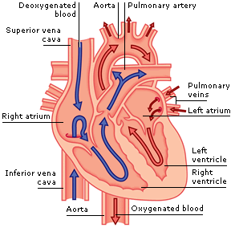
Blood flow in the Heart

Slide 6
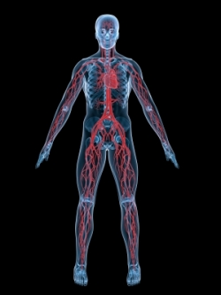
Systemic circulation is the blood flow between the heart and the entire body.
Notes:
The atrioventricular orifice recalls a trapdoor" design in which blood that has accumulated in the atrium "drops through" the opening. The valves are arranged to prevent the flow of blood back into the atrium when the ventricle contracts

Slide 7
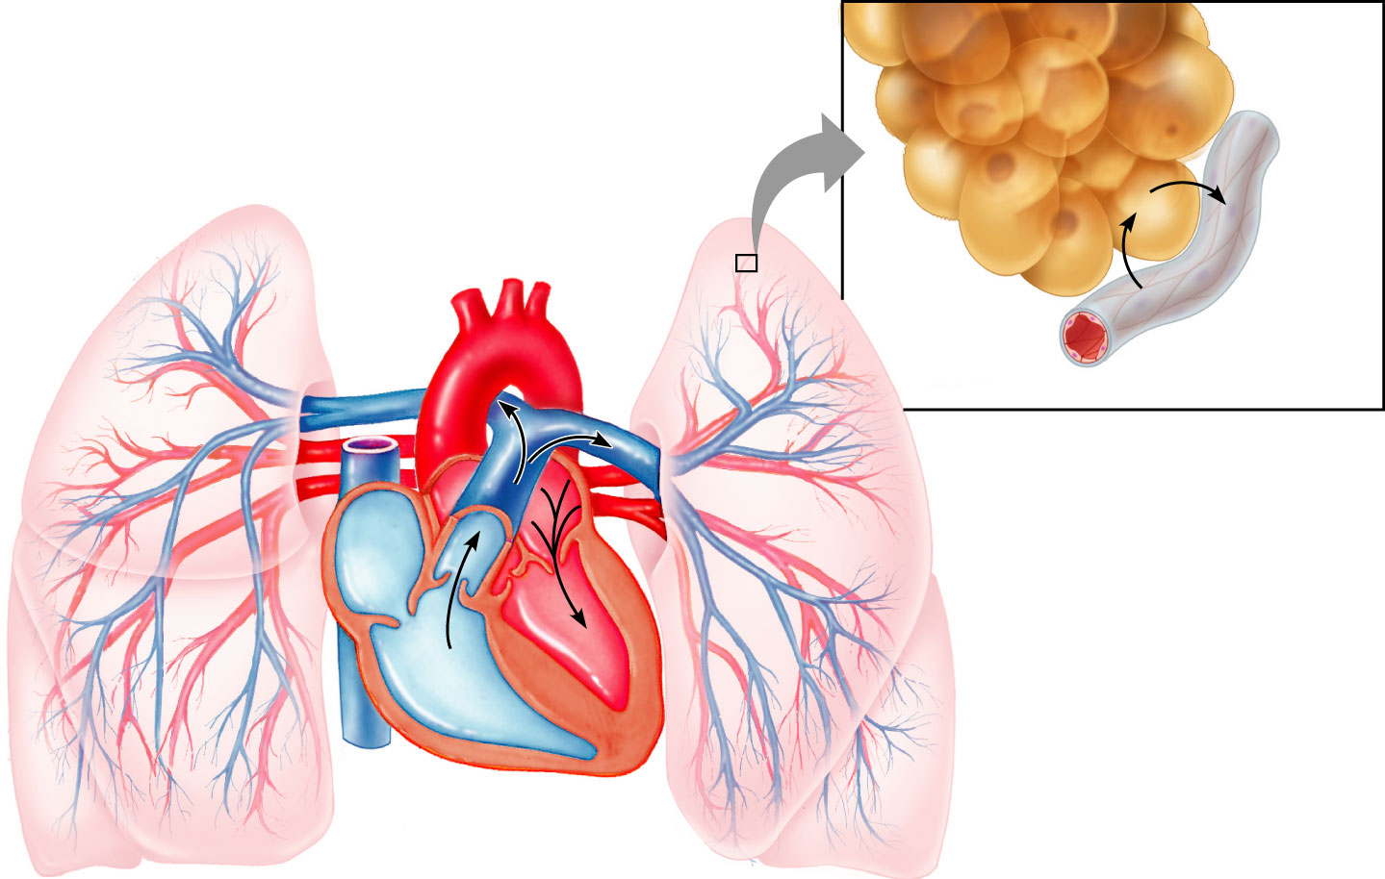
Pulmonary Circulation
circulation of blood between heart and lungs
deoxygenated blood is pumped from the heart to the lungs
oxygenated blood is returned to back to the heart.

Slide 8
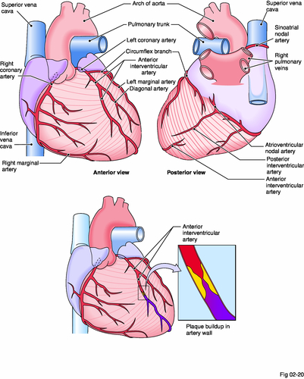
Coronary Arteries
Heart has it’s own blood supply

Slide 9
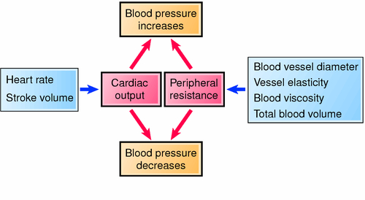
Blood Pressure

