Slide 1
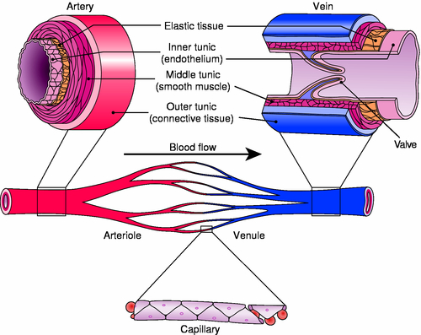
Blood Vessels
Arteries
Move blood away from heart
Arterioles
Capillaries
Veins
Move blood toward heart
Venules, veins

Slide 2
Arteries & Arterioles
Move blood away from heart
Oxygen rich (except pulmonary artery)
Very elastic walls
Three layers (tunics)
Tunica interna
Tunica media
Tunica externa
Notes:
Very elastic walls to ‘store’ energy from the ventricular contraction – to keep blood moving more smoothly
Highly branched like roots

Slide 3
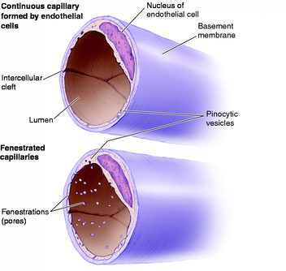
Capillaries
Where exchange of O2 and CO2 takes place
Single endothelial layer
Thin, permeable membrane
Pre-capillary sphincter
Notes:
Highly permeable to O2, CO2, ions, water (all molecules other than proteins – proteins are very large molecules)

Slide 4
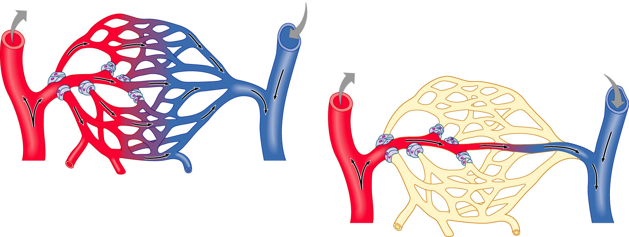
Vascular shunt
Precapillary sphincters
Metarteriole
Thoroughfare
channel
True
capillaries
Terminal
arteriole
Postcapillary
venule
(a)
Sphincters open
Terminal
arteriole
Postcapillary
venule
(b)
Sphincters closed

Slide 5
Veins & Venules
Take blood back to the heart
Oxygen poor blood (except pulmonary vein)
Three lumen (like arteries), but thinner walls
Wide lumen
Blood reservoir (low pressure – high volume)

