Slide 1
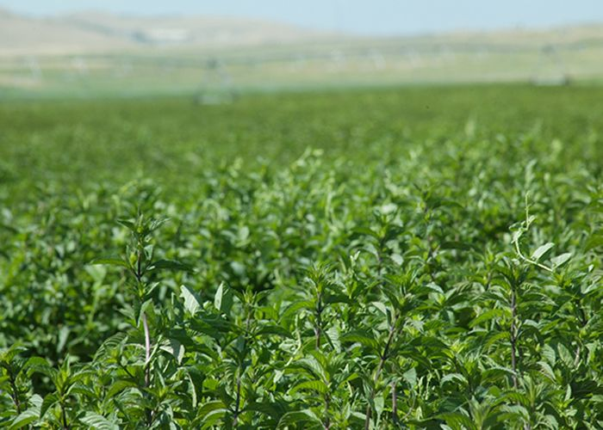
Aromatherapy use of essential oils

Slide 2
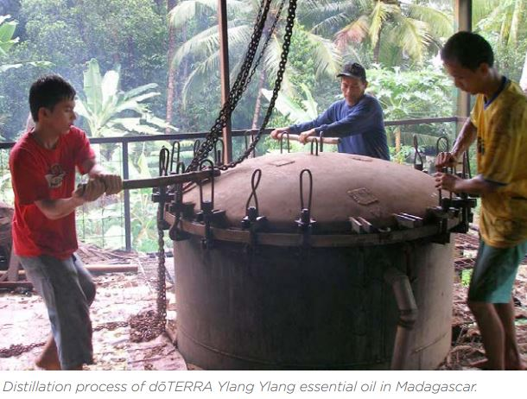
Peppermint
Just one drop of high quality Peppermint essential oil is extremely potent and equivalent to 28 teabags of dried Peppermint herb.
It takes approximately one pound of Peppermint plant material to make a 15 ml bottle of Peppermint essential oil.

Slide 3
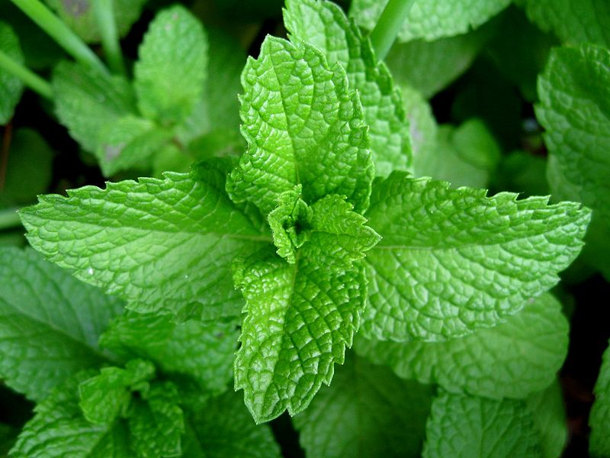
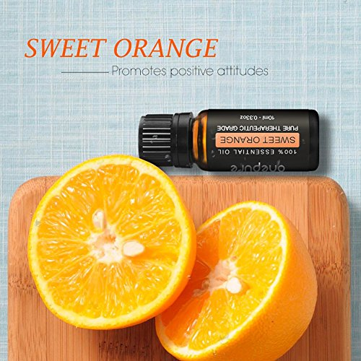
Orange & Peppermint
Uplifting - energizing
Positive mood
Increased focus
Decrease stress-anxiety

Slide 4
Cautions:
Some essential oils may bother students – even triggering or aggravating headaches
Always ask first and only use with permission
I recommend only using
Citrus: orange, grapefruit and lime
Mint
Possibly eucalyptus or cinnamon
I do not recommend: lavender, neroli, ylang ylang, clary sage or many other oils
Use only high quality, pure essential oils, not fragrances
Caution with children, elderly, people with sensitive skin or skin problems, pregnant women, people with epilepsy

